Slide 1


Mobile Price prediction System
Vishwakarma Institute of Technology, Pune
Department of SY Common B-Tech
AY 2021-22
Presentation topic:
Name : Aniruddha Manohar Joshi
Roll No: 51
PRN : 12011234
Subject: SDP
Guide: Prof. Amruta Mankawade

Slide 2
Contents
Aim
Objectives
Problem Statement
Scope of Project
Feasibility of Project
Literature Survey
Tools & Technology
Action plan
Methodology
Limitations and Future Scope
Conclusion

Slide 3
Aim/Problem Statement
To predict the mobile prices and solve the ambiguities of the people while selecting mobile and deploy the ML system with some user interface.
The data contains information regarding mobile phone features, specifications etc and their price range. The various features and information can be used to predict the price range of a mobile phone.

Slide 4

Objectives
To develop and design an interactive deployment of mobile price predicting system using ML.
To simplify the tasks and ambiguity of user.
To help so in mobile searching.

Slide 5

Introduction
Today, Everyone has a smartphone and most of them are ready to change to a new one asap.
Selecting useful parameters and identifying them on a online website or on a store is quite a tedious task.
Many a times, they may get the mobile at a higher price
So, here is a system to predict the price range and to select a useful mobile by a machine learning technique.

Slide 6
Parameters
Primary Camera Megapixels
Pixel Resolution height
Pixel resolution width
RAM in MB
Mobile screen height in cm
Mobile screen width in cm
Longest time after a single charge
3g or not
Has touch screen or not
Has wifi or not
Battery Power in mAh
Has BlueTooth or not
Microprocessor clock speed
The phone has dual sim support or not
Front Camera Megapixels
Has 4G support or not
Internal Memory in GigaBytes
Mobile Depth in Cm
Weight of Mobile Phone
Number of cores in the processor

Slide 7

Scope of Project
The Model still has a scope to train more.
After Taking input from the user about the specifications, it will surely give the price or a price range
The model can have a better deployment on the web.

Slide 8
Literature Survey
Sr. No. | Name of the paper | Authors | Learning techniques | Summary
1 | Online Mobile Price Prediction using Machine Learning(2022) | Miss.A.Renuka , Mr.Veer Sudheer Goud | Python, PHP, HTML, CSS | This work can be concluded with the comparable results of both Feature selection algorithms and classifier. This combination has achieved maximum accuracy and selected minimum but most appropriate features. The system is well deployed. The system is following the pattern of data collection -> dimensionality reduction -> classification. Authors are giving the results whether the mobile is cheap, medium or high priced.

Slide 9
Sr. No. | Name of the paper | Authors | Learning techniques | Summary
2 | Prediction of Mobile Model Price using Machine Learning Techniques(2021) | Kumuda S, Vishal Karur, Karthick Balaje S E. | EDA, Python , KNN | This Project deals with the predication of the price and the features of the mobile . It uses Feature selection to give precise features to be selected and get maximum accuracy results. If there is Forward selection in the data set then it reduces the accuracy of the features and In Backward selection, if we eliminate an important part then its efficiency is reduced. This project model could be improved by developing software that could predict by selecting features
3 | MOBILE PRICE PREDICTION USING WEKA(2020) | Pritish Arora, Sudhanshu Srivastava, Bindu Garg | WEKA, Dimensionallity Reduction, EDA | The experiment is carried out using WEKA (Waikato Setting for the Study of Knowledge). Performed in a steps such as Data Collection, Dimensionality Reduction, Feature Selection, Feature Extraction, Forward Selection, Backward Selection, Classification. The result here is the accuracy of the machine learning model.

Slide 10
Sr. No. | Name of the paper | Authors | Learning techniques | Summary
4 | Developing Artificial Neural Network for Predicting Mobile Phone Price Range (2019) | Ibrahim M. Nasser, Mohammed Al-Shawwa, Samy S. Abu-Naser | Artificial Nural Network | An artificial Neural Network model for predicating mobile phone price range was proposed. The model used feed forward backpropagation algorithm for training. The factors for the model were obtained from data set represents mobile phones specifications. The model was tested and the total result was 96.31% accuracy. This study showed the ability of the artificial neural network to predict mobile phone price range.
5 | Mobile Price Class prediction using Machine Learning Techniques(2018) | Muhammad Asim, Zafar Khan | Machine Learning, Decision Tree, Naïve Bayes | Experiment is carried out by WEKA. Similar to the previous one. This work can be concluded with the comparable results of both Feature selection algorithms and classifier except the combination of Wrapperattribut Eval and Descision Tree classifier. This combination has achieved maximum accuracy and selected minimum but most appropriate features.

Slide 11

Tools & Technology
Jupyter Notebook
Python
Data Science (EDA)
Machine Learning
Sklearn Library
Flask
HTML/CSS

Slide 12
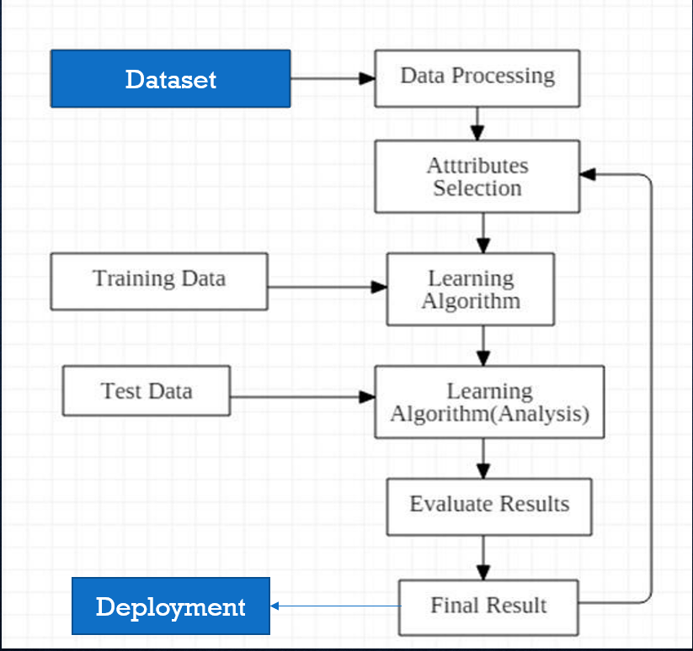
Action plan
.
Proposed Diagram:

Slide 13

Methodology
To collect and explore appropriate datasets.
Cleaning the dataset if required.
Using appropriate language python/R to make a analysis
Exploratory Data Analysis.
Training the model.
Taking appropriate inputs from user.
Deploying the model on a web user interface.

Slide 14
Limitations:
Updated dataset and be a better a option
The system should have Internet connectivity.
Still the model can be modified by exploring the datasets.
Automation especially in today’s world is a never ending thing.
Model can also be modified with better user friendly interface.
Future Scope:

Slide 15
Conclusion
Here, I looked at classification and EDA
Classifiers represent the intersection of advanced machine theory and practical application. These algorithms are more than just a sorting mechanism for organising unlabeled data instances into distinct groupings.
Classifiers include a unique set of dynamic rules that include an interpretation mechanism for dealing with ambiguous or unknown values, all of which are suited to the kind of inputs being analysed.
Most classifiers also utilize probability estimates, which enable end-users to adjust data categorization using utility functions.
While, some techniques such as sklearn, KNN, correlation analysis, etc has also done for EDA.
Notes:
Limitations and future scopes are in my mind to work accordingly

Slide 16
RefErences
https://www.tojqi.net/index.php/journal/article/view/8857/6305
https://www.researchgate.net/publication/323994340_Mobile_Price_Class_prediction_using_Machine_Learning_Techniques
https://www.ijsdr.org/viewpaperforall.php?paper=IJSDR2004057
https://www.kaggle.com/learn/intermediate-machine-learning

Slide 17
Thank You!!

